Slide 1
Converging Challenges to Religious Freedom
Elizabeth A. Clark
Religious Freedom Discussion Series
May 8, 2013

Slide 2
Authoritarian challenges to religious freedom
Religion as a tool of the state to retain the loyalty of the faithful, share high public confidence levels
Religion is invoked when helpful to the state, ignored when not
Minority religions seen as undermining the state; given minimal protections at best

Slide 3
Secularist challenges to religious freedom
See conflicts between traditional religious views and modern understandings of human rights (e.g., same-sex marriage, abortion, sexual orientation rights)
Public religion seen as divisive, anti-liberal, in tension with commitments to equality and neutrality
Religion increasingly moved to private sphere

Slide 4
Challenges to religious freedom from dominant religious traditions and extremists
Religion as core element of national and personal identity
Apostasy as worse than death; betrayal of the community
Role of the state or vigilantes to reinforce religious conformity, punish divergence

Slide 5
Converging challenges
All these challenge religion’s role as part of a vibrant, pluralistic, free, and engaged civil society
  Attempts to limit religious speech, religious choice, autonomy of religious organizations
See wide scope for religious action, choice, and belief as threatening

Slide 6
Religious Sovereignty
Western tradition of religions as sovereigns
Even without territorial sovereignty, religions continue to function as a sovereign
  Assert supreme authority over a realm of human life
  E.g., Tao, dharma, will of Allah, divine law
Rival power structure to the state

Slide 7
Religious freedom as shared sovereignty
States recognition of sovereignty of religions
Creates a space where believers can respond to the claims of their religion while still exercising full citizenship in their secular states

Slide 8
Religious freedom/shared sovereignty as a threat?
Authoritarian regimes see religious freedom as a threat to their power and control
Dominant religious traditions see free religious sector as a threat to their sovereignty and power
Secularist ideologies see strong religious sector as a threat to the secularity and neutrality of the state

Slide 9
Ongoing challenges of religious freedom
How to assert sovereignty and independence of religious beliefs and actors
Finding appropriate limits to manifestations of religion
  “Ambivalence of the sacred” – power of religion for both good and ill

Slide 10
Converging recognition of the importance of religious freedom
New research in:
  Sociology
  Philosophy
  Psychology
  Political Science
  History
  Economics

Slide 11
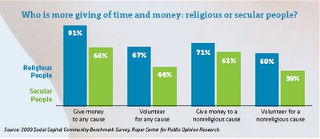
Sociological research
Charitable giving/volunteerism
Notes:
See Arthur Brooks, Who Really Cares (2006), 34-39. See also Arthur C. Brooks, Gross National Happiness: Why Happiness Matters for America—and How We Can Get More of It (2008), 44-52 (statistics on comparative happiness and education of religious individuals); Robert D. Putnam and David E. Campbell, American Grace (2010), 443-492 (various studies on religion and altruism, civic engagement, and “good neighborliness”); see also Ram A. Cnaan, et al., The Newer Deal: Social Work and Religion in Partnership (1999); Ram Cnaan, The Other Philadelphia Story (2006).

Slide 12
Philosophy - Virtue Ethics
Religion as essential to the development of democratic values such as tolerance, reflective thinking, generosity, altruism, law-abidingness
Respect for religion as part of the value of reverence, “the virtuous capacity for awe, respect, and shame” in the face of what “cannot be changed or controlled by human means”
Provides normative grounding for religious freedom
Notes:
See, e.g., Peter Berkowitz, Virtue and the Making of Modern Liberalism (1999), xi; Paul Woodruff, Reverence: Renewing a Forgotten Virtue (2002); Frank C. Richardson, Virtue Ethics, Dialogue, and “Reverence,” 43 Amer. Behav. Scientist (2003), 442.

Slide 13
Communitarianism
Challenges views of society as comprised of atomistic individuals
Emphasizes importance of civil society and community
Sees modern liberalism as self-undermining because it “cannot secure the liberty it promises, because it cannot inspire the sense of community and civic engagement” that individual liberty requires
Many recognize importance of religious organizations as part of our social fabric
Notes:
Michael Sandel, Democracy’s Discontent: America in Search of a Public Philosophy (1996), 6; see also Mary Anne Glendon, Rights Talk (1992); Putnam and Campbell, American Grace (2010). Other major communitarian thinkers include Amitai Etzioni, Michael Walzer, Alasdair MacIntyre.

Slide 14
Evolutionary Psychology
Jonathan Haidt
Human nature has an ability to transcend self-interest, lose ourselves in something larger
“hive switch” ensures natural selection at a group level
Religious practices, norms, and relationships bind people into groups that form moral communities
Increases our ability to cooperate, selflesness
Notes:
Jonathan Haidt, The Righteous Mind: Why Good People Are Divided by Politics and Religion (2012); other articles by Haidt.

Slide 15
Religion, violence, and peace
Supporting religious freedom promotes religion’s “capacity to perform a range of positive functions in society,” including:
  Promoting democracy
  Mediating an end to violent conflicts
  Providing increased social services
  Catering to diverse religious preferences of society
  Encouraging political moderation
Religious freedom reduces likelihood that religions will turn violent
Notes:
Monica Duffy Toft et al., God’s Century: Resurgent Religion in Global Politics (2011), 18; see also Gerard F. Powers, “Religion and Peacebuilding” in Daniel Philpott and Gerard F. Powers, eds., Strategies of Peace: Transforming Conflict in a Violent World (2010); R. Scott Appleby, The Ambivalence of the Sacred: Religion, Violence, and Reconciliation (1999).

Slide 16
Religion and social stability
Religious violence cycle:
Notes:
Brian Grim, Religious Freedom: Good for What Ails Us?, 6 Faith & Int’l Affairs (Summer 2008). See also Brian J. Grim and Roger Finke, The Price of Freedom Denied: Religious Persecution and Conflict in the Twenty-First Century (2010).

Slide 17
Religion and social stability
Religious freedom cycle:
Notes:
Brian Grim, Religious Freedom: Good for What Ails Us?, 6 Faith & Int’l Affairs (Summer 2008). See also Brian J. Grim and Roger Finke, The Price of Freedom Denied: Religious Persecution and Conflict in the Twenty-First Century (2010).

Slide 18
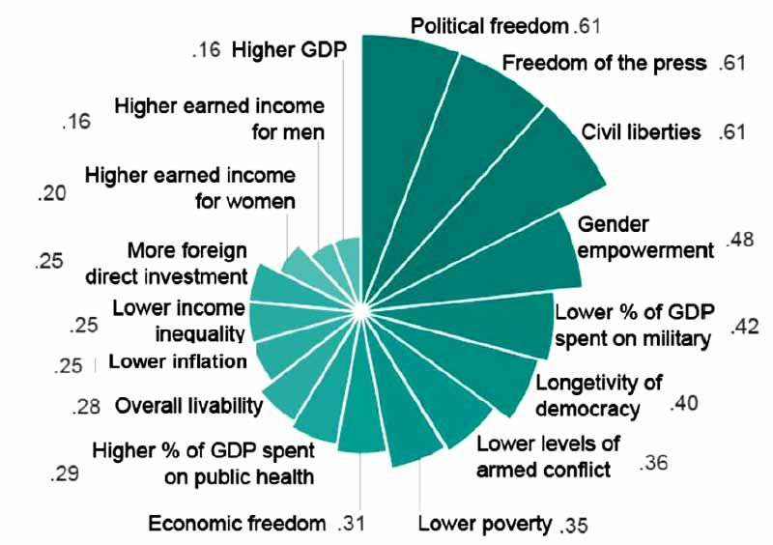
Religious freedom and other freedoms and benefits
Notes:
Brian Grim, Religious Freedom: Good for What Ails Us?, 6 Faith & Int’l Affairs (Summer 2008). See also Brian J. Grim and Roger Finke, The Price of Freedom Denied: Religious Persecution and Conflict in the Twenty-First Century (2010).

Slide 19
History
Philip Jenkins – persecuted religions
  Go underground
  Often adopt active and effective military traditions
  Cultivate violent and apocalyptical ideologies to make sense of their suffering
  Encourage withdrawal from a perceived hostile outside world
  Provide justification or support for attacks from co-religionists elsewhere
Religious persecution “can thus provide massive obstacles to nation-building, and to creating a stable, just, and secure international order.”
Notes:
Philip Jenkins, “The Politics of Persecuted Minority Religions” in Robert A. Seiple and Dennis R. Hoover, Religion and Security: The New Nexus in International Relations (2004), 25-36.

Slide 20
Economics
Government regulation of the religious market has been shown to decrease religiosity in the country as a whole
Greater religious pluralism is associated with higher religious participation and belief levels
Notes:
Robert J. Barro and Rachel McCleary, Religion and Economic Growth across Countries, American Sociological Review (October 2003).

Slide 21
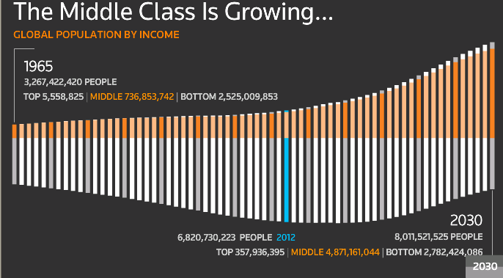
Growth of the global middle class
Notes:
See Robert J. Barro, Determinants of Democracy, 107 Journal of Political Economic (December 1999), S158, S159; see also Christopher Clague, Suzanne Gleason and Stephen Knack, Determinant of Lasting Democracy in Poor Countries: Culture, Development, and Institutions, Annals of the American Academy of Political and Social Science (January 2001); Charles Murray, Coming Apart: The State of White America, 1960-2010 (2013).

Slide 22
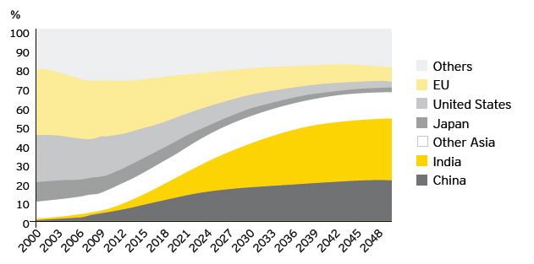
Shares of middle-class consumption, 2000-2048
Notes:
OECD Development Centre Working Paper No. 285 DEC/DOC(2010)2; Mario Pezzini, An Emerging Middle Class, OECD Observer, available at http://www.oecdobserver.org/news/fullstory.php/aid/3681/An_emerging_middle_class.html

Slide 23
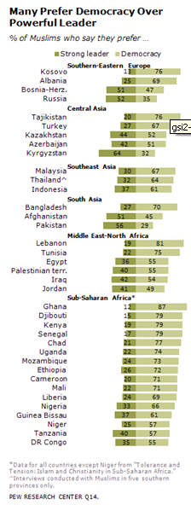
Democratic preferences in Islamic world
Notes:
Pew Research Center, The World’s Muslims: Religion, Politics, and Society (April 30, 2013), available at http://www.pewforum.org/Muslim/the-worlds-muslims-religion-politics-society.aspx

Slide 24
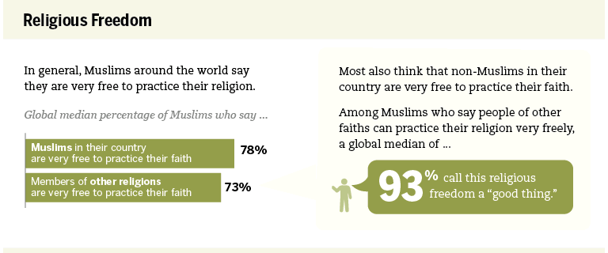
Pew Survey Report
Notes:
Pew Research Center, The World’s Muslims: Religion, Politics, and Society (April 30, 2013), available at http://www.pewforum.org/Muslim/the-worlds-muslims-religion-politics-society.aspx

Slide 25
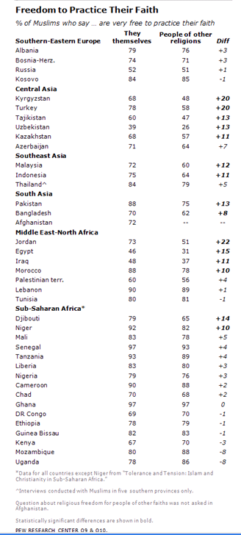

Slide 26
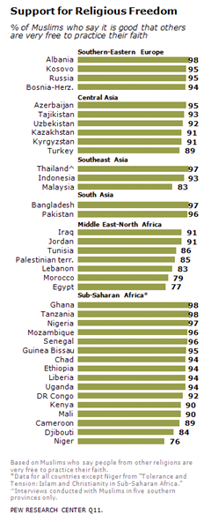

Slide 27
Growing recognition of benefits of religion
Correlates with increased charitable giving and volunteering
Contributes to development of democratic values such as reflective thinking, generosity, altruism, and reverence
Provides important part of our social fabric, inspiring sense of community and civic engagement

Slide 28
Growing recognition of benefits of religion
Builds set of norms, relationships, and institutions that strengthen our ability to cooperate, transcend self-interest and increase social capital such as trust
Promotes democracy, assists in mediating an end to violent conflicts, providing social services, encouraging political moderation
Is associated with higher income levels and increased levels of democratization

Slide 29
Recognition of the importance of religious freedom
Increases religious participation and belief levels, leading to increased positive contributions of religion to society
Reduces violence associated with religion
Increases national security by undermining self-reinforcing narratives of persecution by minority groups
Correlated with other freedoms and social goods

Slide 30
Non-instrumental value of religion
Hans Joas
“The questions is not ‘Is religion useful?’ but ‘Can we live without the experience articulated in faith, in religion?’”
Value of self-transcendent experiences
Religious traditions articulate these self-transcendent experiences and enable us to have such self-transcendent experiences in the first place
Notes:
Hans Joas, Do We Need Religion?: On the Experience of Self-Transcendence (2008), 7-25.

Slide 31
Non-instrumental value of religious freedom
Religious pluralism and freedom as flowing from deep religious conviction
Wanting others “to have the opportunity to develop their own authentic and unforced relationship to God.”

