Slide 1
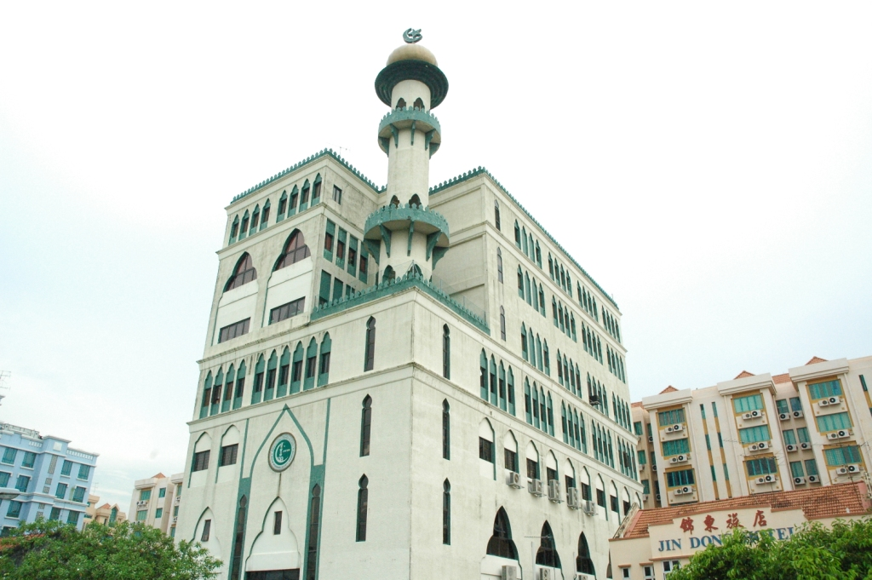
Twenty-Third Annual International Law and Religion Symposium Brigham Young University, Utah, USA
MIN0RITIES, MAJORITIES AND RELIGIOUS RIGHTS-
A NARRATIVE ON MUSLIMS IN SINGAPORE
Dr. H. Mohamed Saleem
Vice President-I,
Jamiyah Singapore

Slide 2
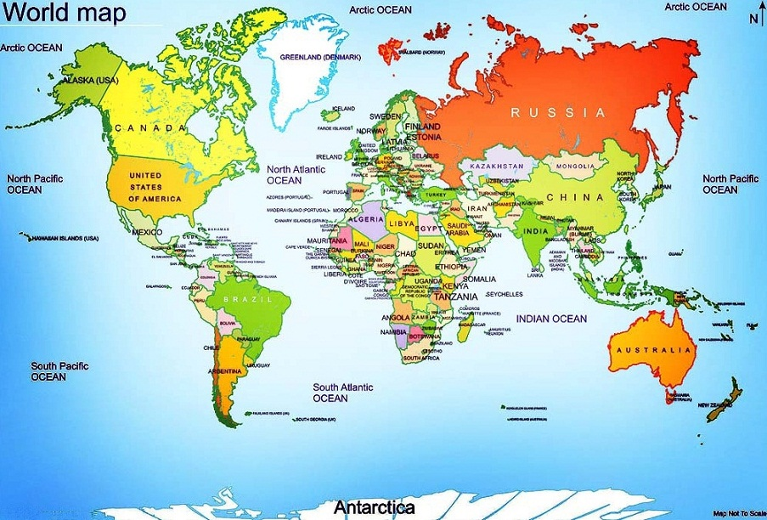

Slide 3
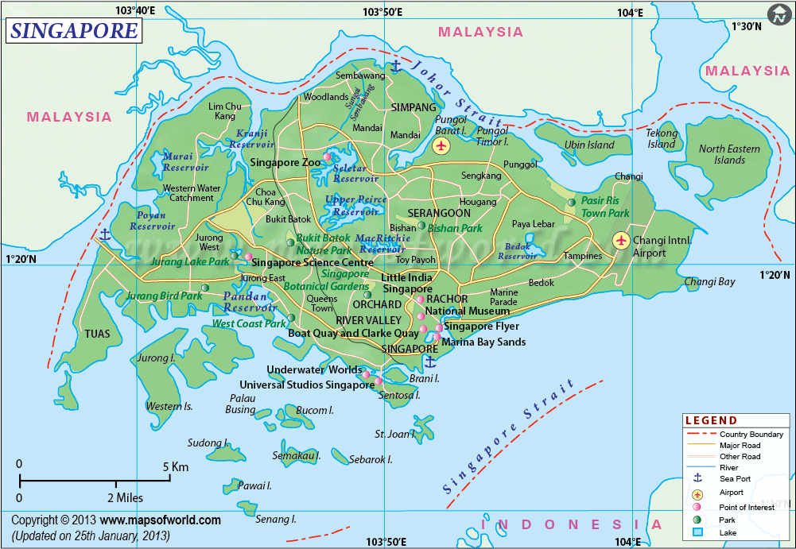

Slide 4
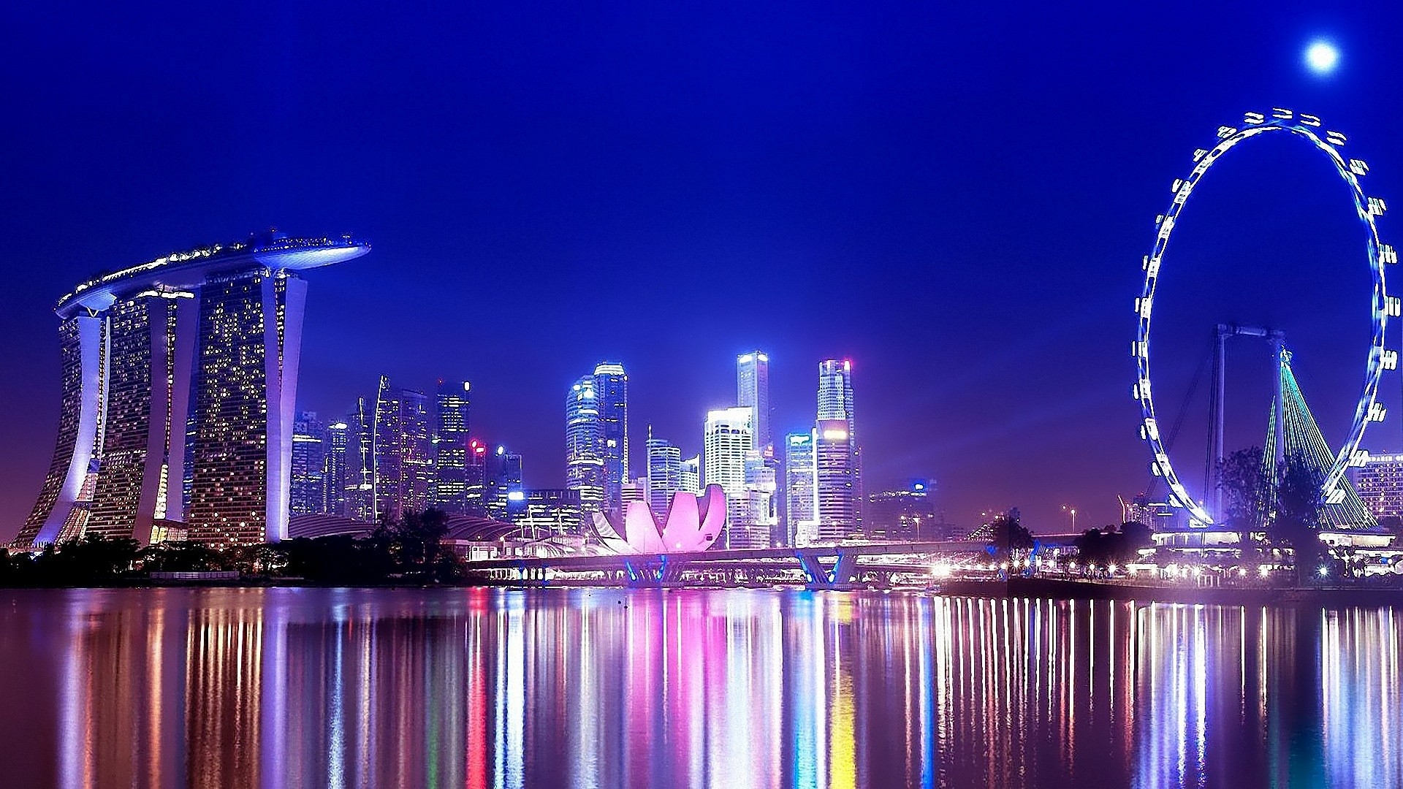

Slide 5
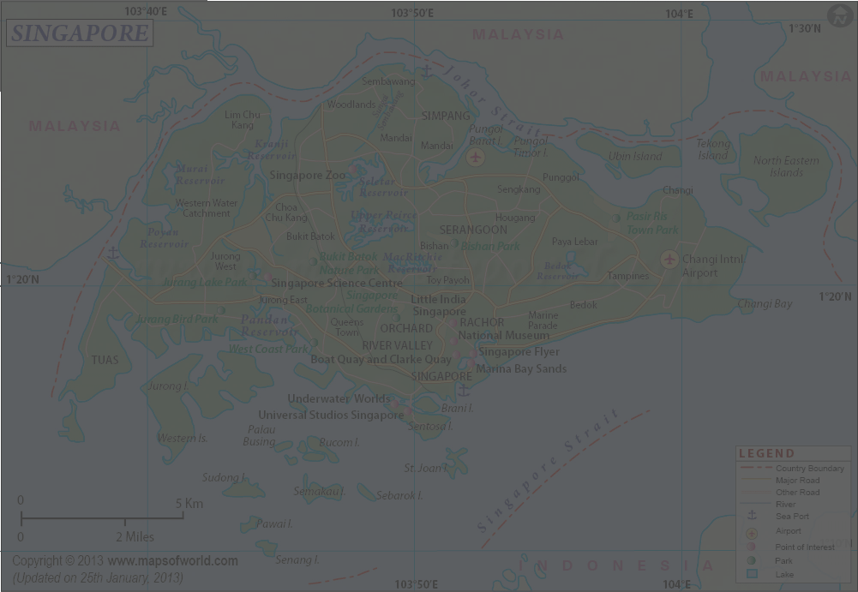
Singapore gained its independence from the British when it joined the Federation of Malaysia on 16th September 1963.
On 9th August 1965 it separated from Malaysia and became known as the Republic of Singapore.
Singapore is a multiracial city state, whose elected government is secular and practices a system of parliamentary democracy.

Slide 7
SINGAPORE has
an area of
719 square kilo metres
and a total population of
5.7 million.

Slide 8
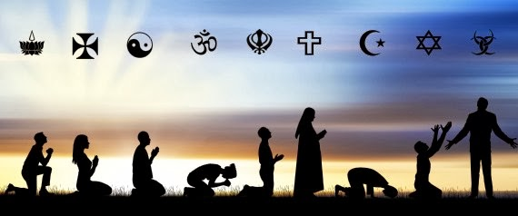
Religion in Singapore is characterized by a diversity of religious beliefs and practices due to its diverse ethnic mix of peoples originating from various countries. Singapore is considered to be the world’s most religiously diverse nations.

Slide 9
83 percent of citizens and permanent residents profess some religious faith. Buddhism, Christianity, Islam, Taoism and Hinduism make up 82.3 percent and the remainder is composed of atheists, agnostics, and other religions including Sikh, Jewish, Zoroastrian and Jain communities.

Slide 10
Freedom and Religion in Singapore
Article 15 of the Constitution of the Republic of Singapore guarantees freedom of religion in Singapore. Article 15(1) states: “Every person has the right to profess and practice his religion and to propagate it.”

Slide 11
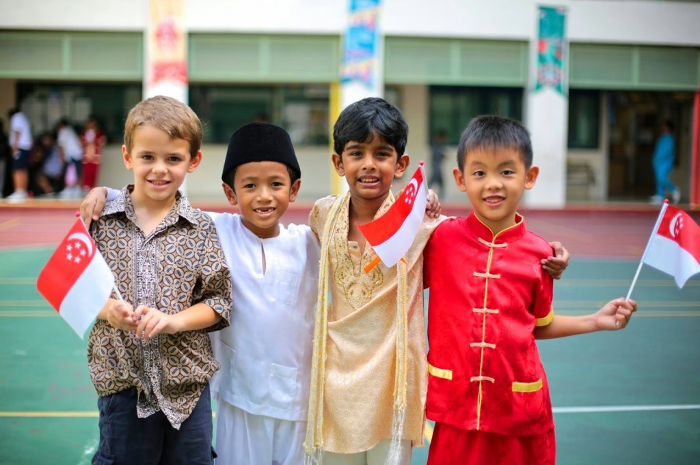
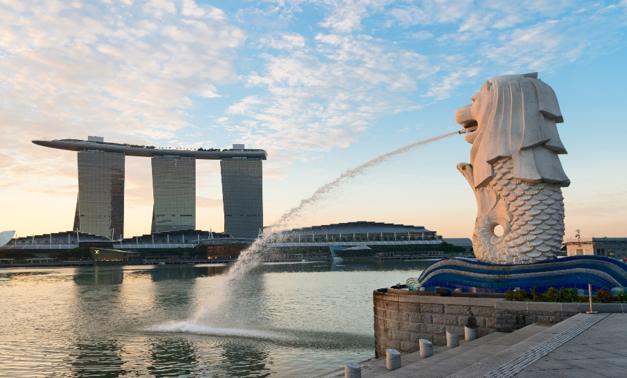
Minorities in Singapore
Singapore’s approach to minorities have by and large been much more positive. Its legislation and policies in relation to the main minorities in the country have thus been successfully based on what could be called a form of ‘proportionality’.

Slide 12
Minorities in Singapore
The Muslim, Hindu, and Christian religions being recognized and celebrated during public holidays, as well as the English, Tamil and Malay languages being used for official purposes in ways that roughly correspond to their relative proportion in the society. These and other initiatives can be said to have been effective since the 1970s to enhance ethnic tolerance and promote harmony.

Slide 13
Minorities in Singapore
The Constitution provides that legislation passed by Parliament must be scrutinized by a Presidential Council for Minority Rights to ensure that there are no measures which discriminate against a minority community.

Slide 14
Minorities in Singapore
Arising from the parliamentary Act for the Maintenance of Religious Harmony, a Presidential Council for Religious Harmony exists to look into this important issue. It consists of representatives from the government and religious representatives.

Slide 15
Minorities in Singapore
Over and above such safeguards, there are many Inter Racial and Religious Confidence Circles (IRCCs) exist at grassroots levels.
The IRCCs have worked hard over the years to build strong relationships amongst leaders of different racial and religious groups.

Slide 16
Minorities in Singapore
They complement the work of interfaith organizations such as the Inter-Religious Organisation Singapore which was founded by the founder of Jamiyah, Maulana Muhammad Abdul Aleem Siddique in 1949 enlisting the support and cooperation of other faith leaders.

Slide 17
Minorities in Singapore
In terms of race relations Singapore Government is proactive in addressing to the sensitivities of different races including the minorities.

Slide 18
Minorities in Singapore
In his recent interview to the mainstream media Prime Minister Lee Hsien Loong said that he looks forward to the election of a minority Presidential candidate in the forthcoming presidential election. Singapore had one Malay president, the late Mr Yusof Ishak, who was appointed to the office at the country's founding.

Slide 19
Minorities in Singapore
Since the Elected Presidency was instituted in 1991, the country has not had a Malay president. From 1999 to 2011, Singapore had the late Mr S R Nathan, who was elected unopposed in 1999 and 2005. He observed that a mechanism such as the multi-racial Group Representation should be applied to presidential election also to ensure that minorities can be periodically elected if we have not had a particular minority as President for some time.

Slide 20
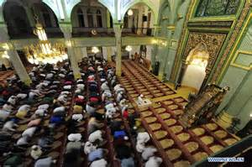
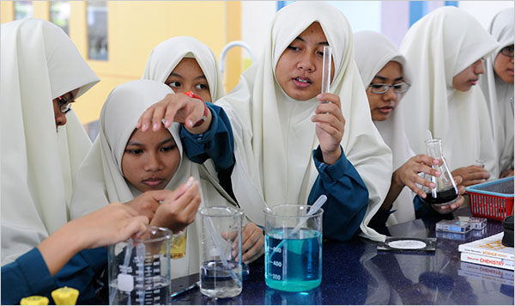
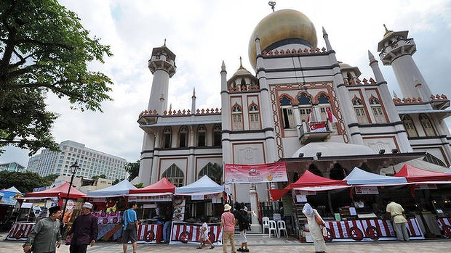
Muslims in Singapore Today
Since early 20th Century there have been Advisory Councils recognized by the authorities as representative of the Muslim community. Today by virtue of the Administration of Muslim Law Act , passed by Parliament, the Islamic Religious Council of Singapore widely known as MUIS as the logical development of the earlier advisory councils , came into being together with a revamped Syariah Court- which deals with Islamic Family Law- and the Registry of Muslim Marriages.

Slide 21
Muslims in Singapore Today
MUIS oversees the running of endowments, madrasahs, and 70 mosques including several purpose-built modern mosques in public housing estates where the majority of Singaporeans live. MUIS also collects and administers zakat funds. The Mosque Building and Mendaki Fund also comes within its ambit. It collects computerized monthly contributions from all Muslim workers and employers.

Slide 22
Muslims in Singapore Today
Today out of 101 Members of Parliament, 14 are Muslims of whom four are female Members. Also among the Muslim Parliamentarians some are holding key positions in Government such as Speaker of Parliament, two cabinet Ministers, One Senior Minister of State and two Parliamentary Secretaries.
Muslim Non-Governmental organizations play active role in Singapore catering for various objectives such as social welfare, cultural, literary, credit benefits, youth, women, elder and health care, education and inter-faith and inter-racial harmony work, education and Islamic research and activities.

Slide 23
Muslims in Singapore Today
The oldest and probably the largest Muslim NGO was the Muslim Missionary Society which was formed in 1932 and which created several branches in Singapore as well as peninsular Malaya. When the island republic gained its full independence upon separation from Malaysia on 9th August 1965 The All Malaya Muslim Missionary Society became known as The Muslim Missionary Society Singapore also known as JAMIYAH SINGAPORE.

Slide 24
Role of Muslim NGOs in promoting the culture of Peace and Harmony
They engage in a range of activities across the humanitarian spectrum. They take active part in the shaping and implementation of appropriate service strategy to reach out to the needy and disadvantaged section of society, regardless of race or faith and thus instils confidence and trust among other communities .They play a strategic role in strengthening bonding reinforcing the processes of identity and connection that comprise the social fabric of communities.

Slide 25
Role of Muslim NGOs in promoting the culture of Peace and Harmony
There is increasing recognition of the role of Muslim NGOs in Singapore by various stake holders such as Government Ministries, Self-help groups and other professional agencies. The numerous programmes managed by organizations such as Jamiyah Singapore which is geared towards serving all needy Singaporeans , Muslims and others, is endorsed by the strong support that the organization is receiving from across all Singaporeans , businessmen, philanthropists and individuals.

Slide 26
Role of Muslim NGOs in promoting the culture of Peace and Harmony
Thus Muslim NGOs also play a very important role, not only in meeting the dire needs of the disadvantaged sections of the society , but in the process enhances mutual good will, trust and confidence of every one and thus enhances the image of Islam and Muslims in Singapore.

Slide 27
CONCLUSION
Singapore’s racial and cultural diversity came about from its history as a trading hub located along busy sea routes. We thrived because we were open to not only the trading of physical goods, but also to the different cultures, languages, religions and technologies of these traders. Our openness to this international trade flow, knowledge and cultures has brought us opportunities and progress. As Singapore matures as a nation, our shared values have created common social and cultural spaces that enable us to interact freely in our daily lives.

Slide 28
CONCLUSION
A better understanding of each community’s aspirations leads to tolerance and racial harmony in our society, which is a fundamental pillar of Singapore’s stability. The Singapore Government regularly takes proactive steps to promote and enhance racial harmony by emphasising tolerance, understanding and respect among the many ethnic groups in our country. This pragmatic approach helps us acknowledge and respect the differences in our multi-ethnic society and hone this quality as our strength.

Slide 29
شُكرًا
THANK YOU

